Slide 1
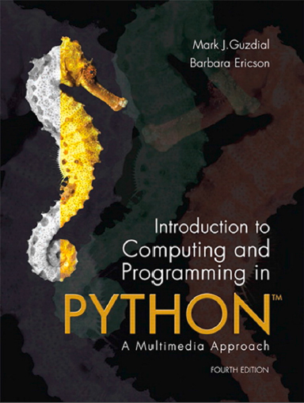
Introduction to Computing and Programming in Python™: A Multimedia Approach
Fourth Edition
Chapter 16
Topics in Computer Science: Functional Programming
Copyright © 2016, 2013, 2010 Pearson Education, Inc. All Rights Reserved
Notes:
If this PowerPoint presentation contains mathematical equations, you may need to check that your computer has the following installed:
1) MathType Plugin
2) Math Player (free versions available)
3) NVDA Reader (free versions available)
Thanks to John Sanders of Suffolk University for contributions to these slides!

Slide 2
Learning Objectives
16.1 To write programs more easily with more functions.
16.2 To use functional programming to make powerful programs quickly.
16.3 To understand what makes functional programming different from procedural or imperative programming.
16.4 To be able to use else in Python.
16.5 To be able to use global in Python.

Slide 3
Functions: What’s the Point?
Why do we have functions?
More specifically, why have more than one?
And if you have more than one, which ones should you have?
Once I have functions, what can I use them for?

Slide 4
Functions are for Managing Complexity
Can we write all our programs as one large function? YES, but it gets HARD!
As programs grow in size, they grow in complexity.
How do you remember the details like inserting
tags?
Put them inside of functions
How do you change the function over time and find the right place to make the changes you want?
If the function performs a specific role, then if you have to change that role, you change that function.
How do you test and debug your program?
You can put print statements in the whole thing, or, you can test individual functions first.

Slide 5
Advantages to Using Functions
Hides details so that you can ignore them.
Makes it clear where you should make changes.
If you need to change the title, it’s probably in the title() function.
Makes testing easier.
Helps you in writing new programs because you can reuse trusted, useful functions.

Slide 6
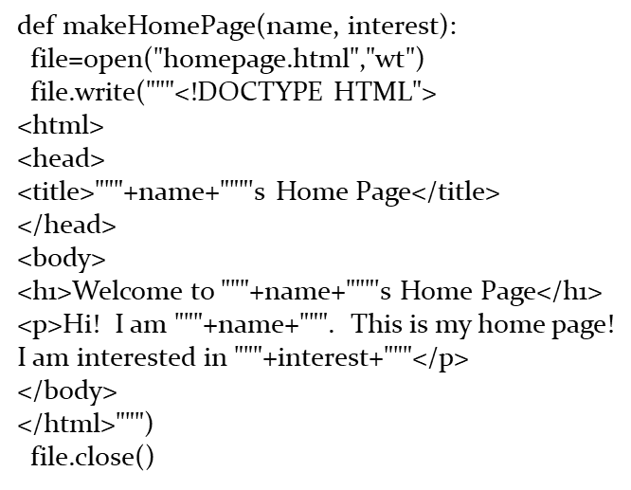
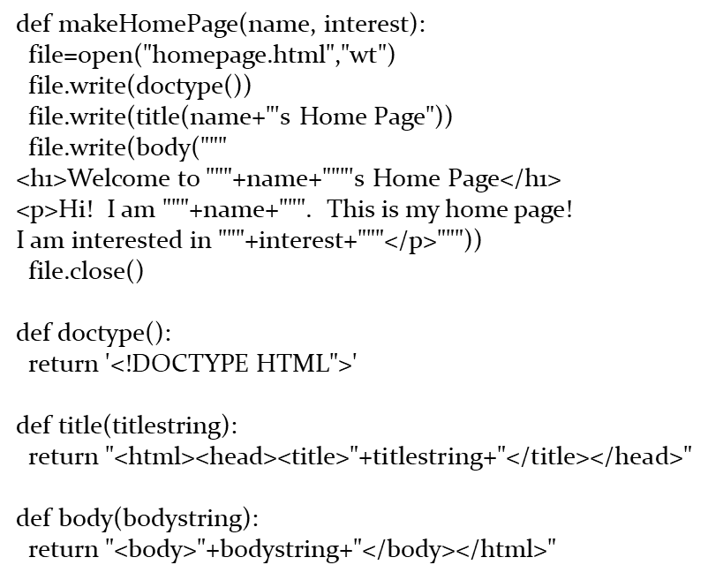
Example: Generating a Home Page
Which one of these is simpler?

Slide 7
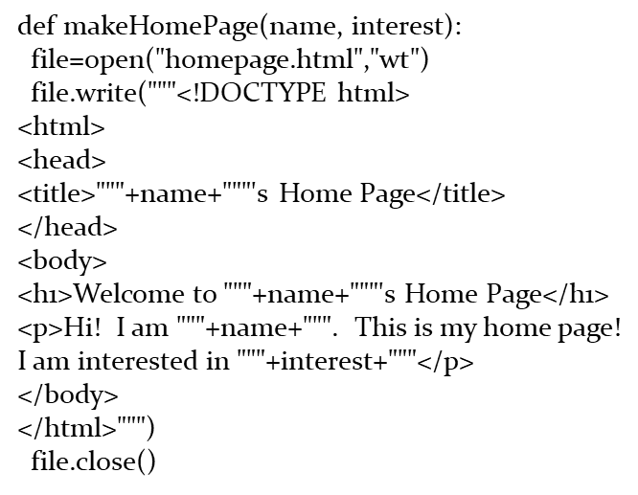
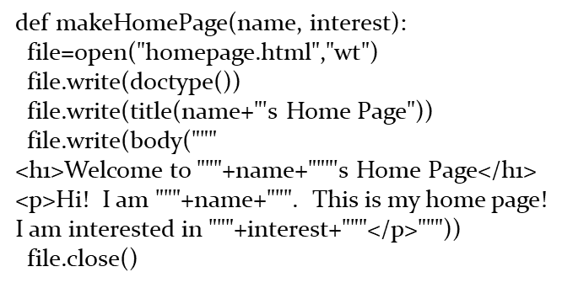
Focusing on the Part That We Would Most Likely Change
Now which one is simpler?
Simpler to change? Simpler to modify?

Slide 8
Making Testing Simpler
We can now check the individual pieces, rather than only the whole thing.
If the individual pieces work, it’s more likely that the whole thing works.
You still have to make sure that the pieces fit together well (called integration testing), but you already know what the pieces do and if the pieces work.

Slide 9
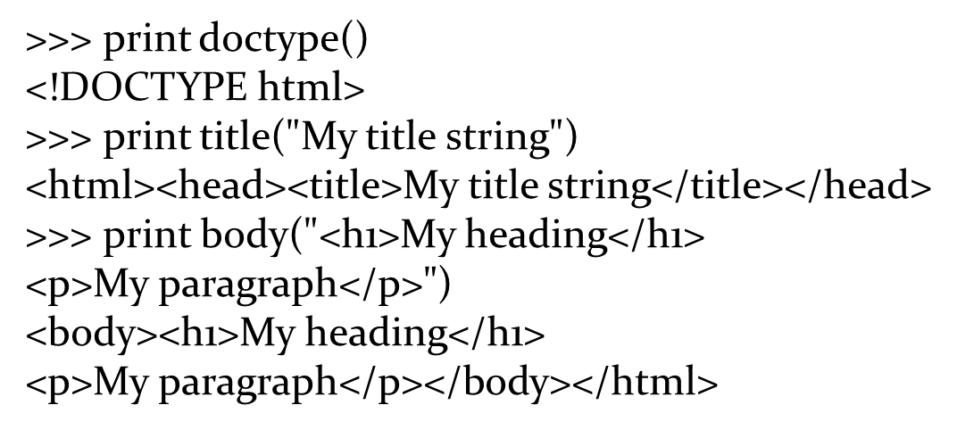
Example: Testing the Pieces

Slide 10
Adding Functions Makes It Simpler If the Functions are Chosen Well
What if we had sub-functions that did smaller pieces of the overall task?
We call that changing the granularity
Is that better or worse?
It’s better if it makes the overall program easier to understand and to change.
It’s worse if it simply swaps one kind of complexity for another.

Slide 11
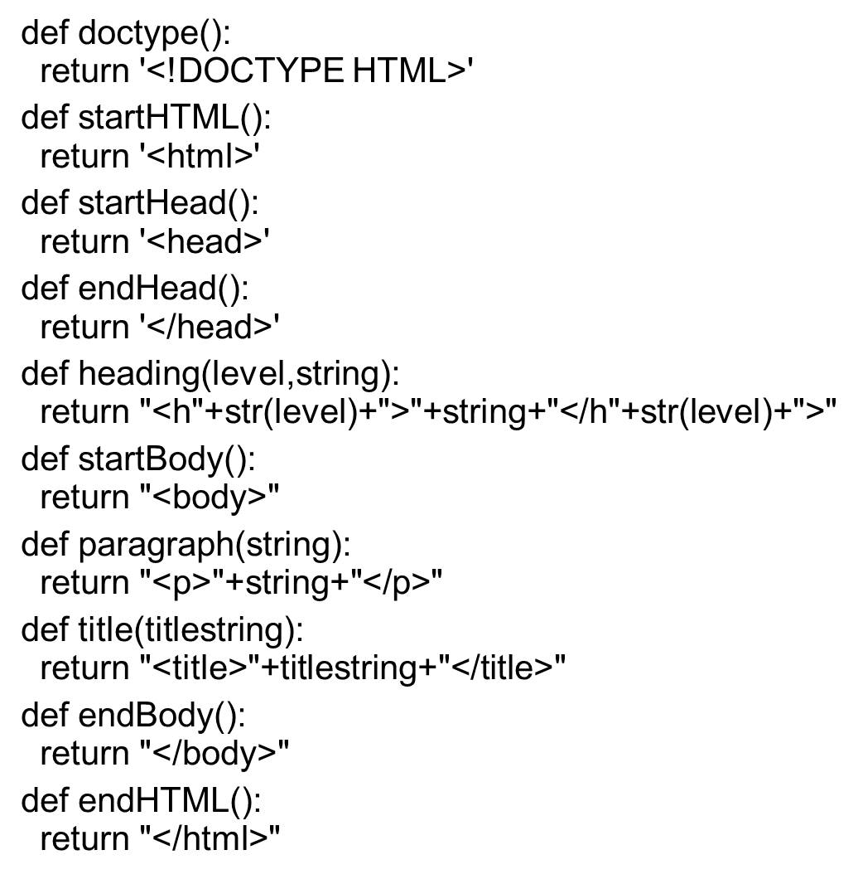
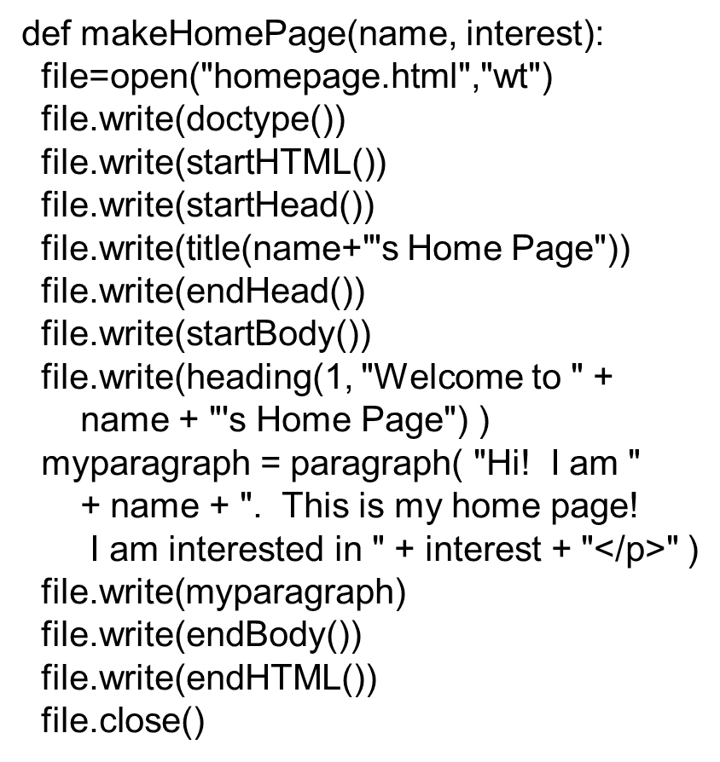
Changing the Granularity Smaller

Slide 12
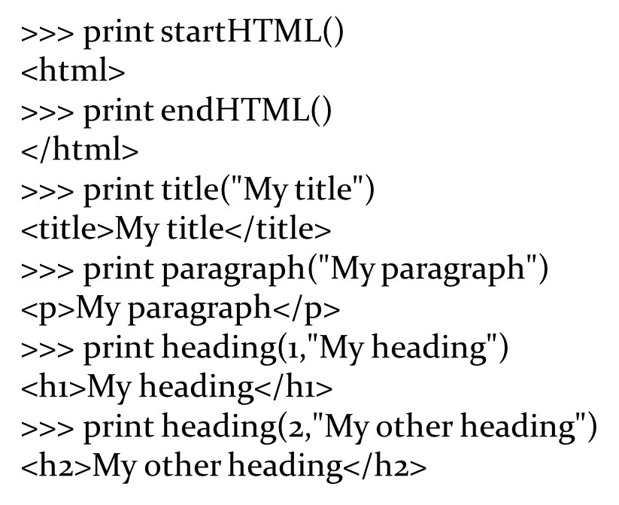
This is Easy to Test!

Slide 13
Your Goal with Testing Functions: Trust
Do you know what the function is supposed to do?
Do you really understand it?
Does it do what you expect it to do?
For whatever input you give it?
Key Idea: Can you now forget about how it works and just assume that it does work?

Slide 14
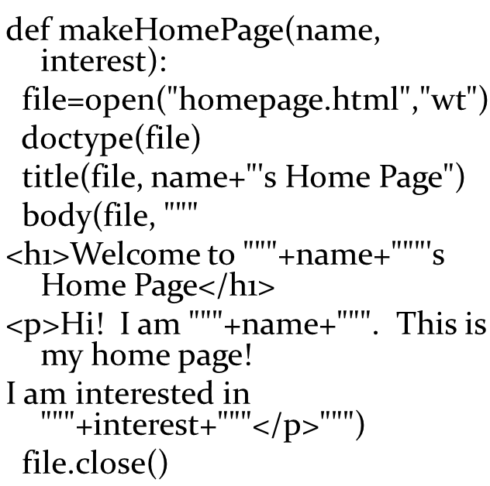
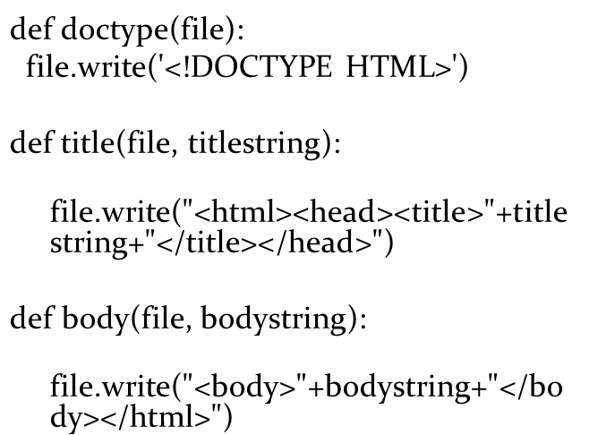
Changing the Granularity Larger

Slide 15
Tradeoffs in This Granularity
Advantages:
Main function is even easier to read.
More details are hidden, e.g., file writing
Disadvantages:
Harder to test.
There are more parameters to the function, so you’ll have to create a file to test them.
Then you can’t see the result of the test until you check the file.

Slide 16
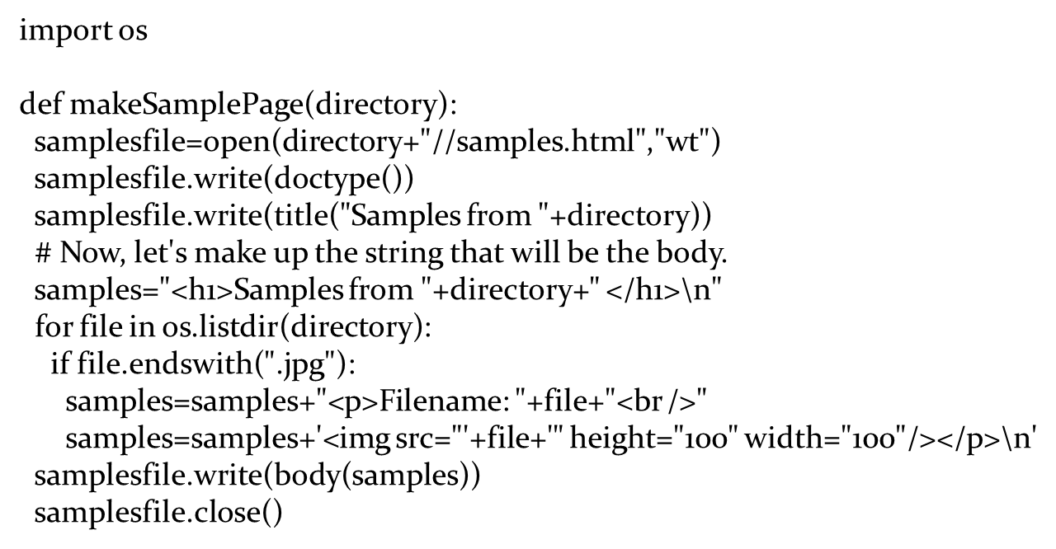
Using Subfunctions to Ease Testing and Complexity
Recall this program

Slide 17
What’s the Hard Part? That Loop Body!
Useful heuristic (rule of thumb): If it’s hard, break it out into a subfunction so that you can debug and fix that part on its own.
Notes:
Heuristics don't always work, but often do.

Slide 18
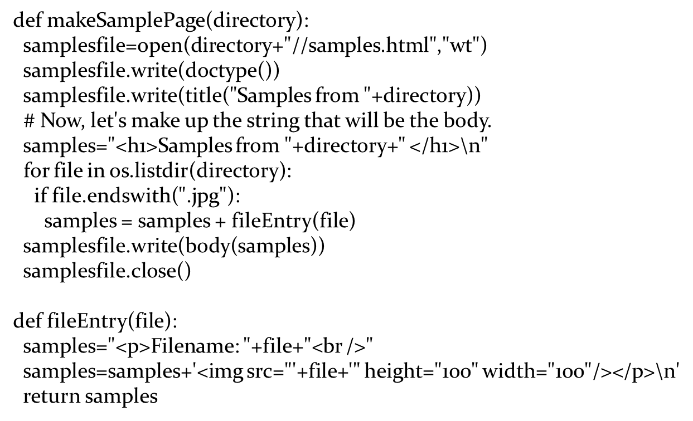
Breaking out the Loop Body

Slide 19
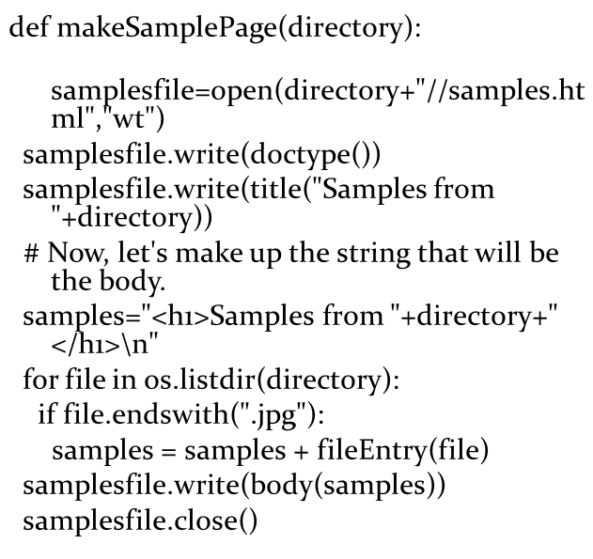
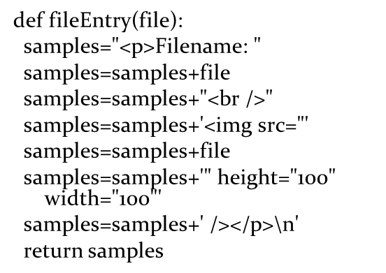
Use More Lines, If You Want
If it makes the code make more sense to you, do it that way!

Slide 20
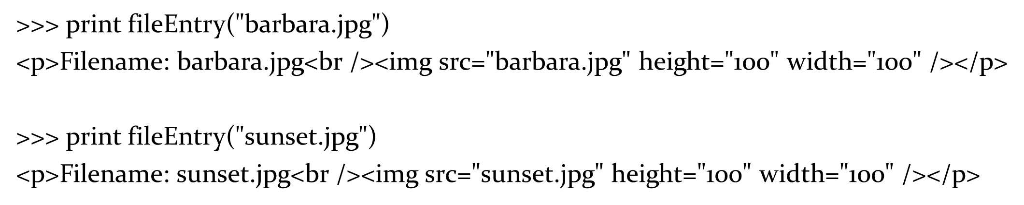
Testing It by Itself

Slide 21
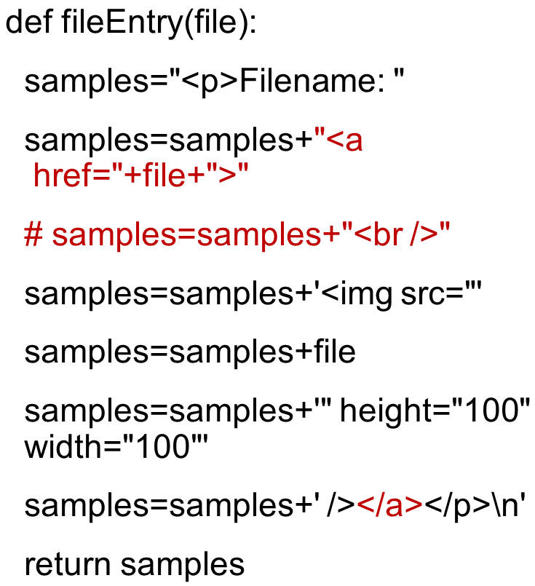
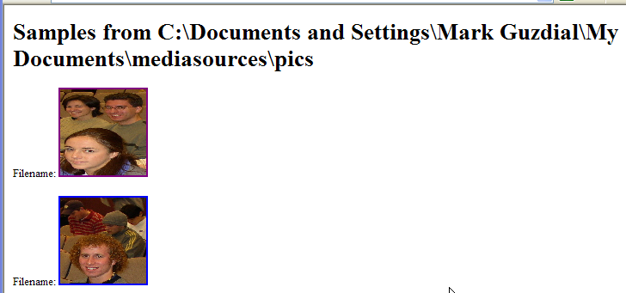
Changing the Program: Making the Images Links

Slide 22
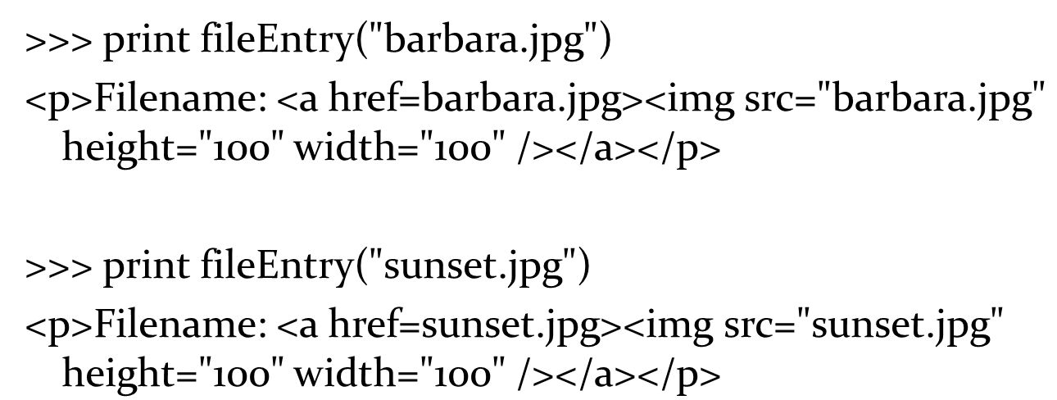
Testing the Links Version

Slide 23
Changing the Program Considerably
What if we want to process pictures and sounds separately?
How do we think about that?
We use a process called procedural abstraction

Slide 24
Procedural Abstraction
State the problem.
Break the problem into sub-problems.
Keep breaking the sub-problems into smaller problems until you know how to write that chunk.
Goal: Main function is basically telling all the sub-functions what to do.
Each sub-function does one logical task.

Slide 25
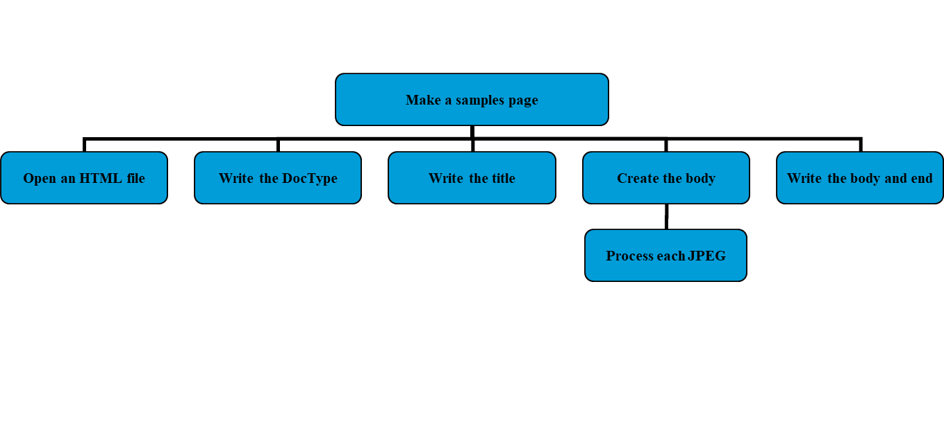
What Are the Problems and Sub-Problems We’re Solving Now?

Slide 26
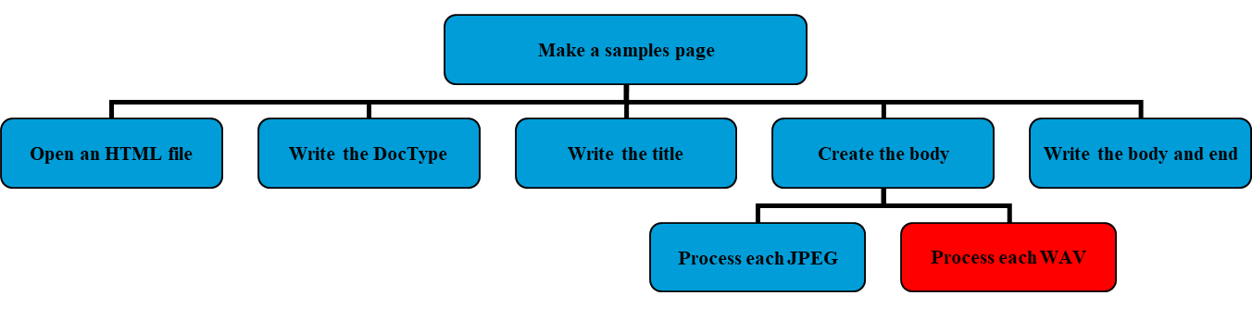
What We Want to Change: Processing W A V Files, Too

Slide 27
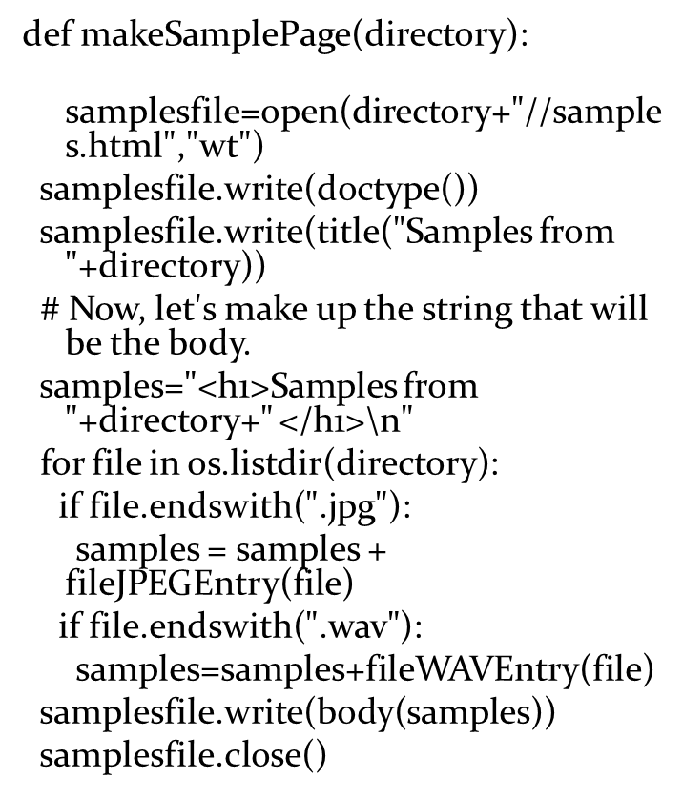
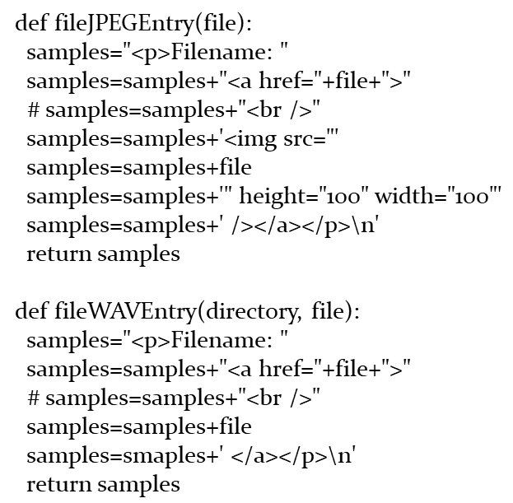
Version 1: Not Too Different

Slide 28
What If We Computed Sizes?
We’ll have to pass in the directory
Because now we have to find the actual file
Code gets a little more complicated

Slide 29
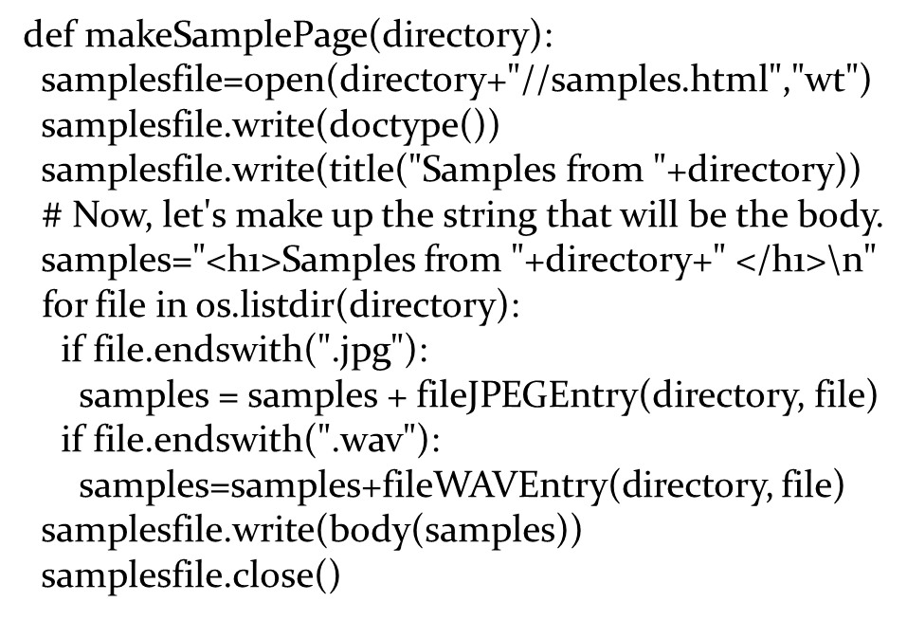
Main Function

Slide 30
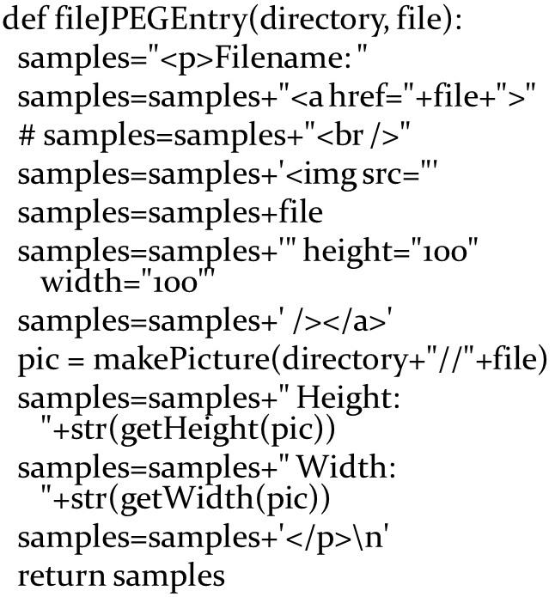
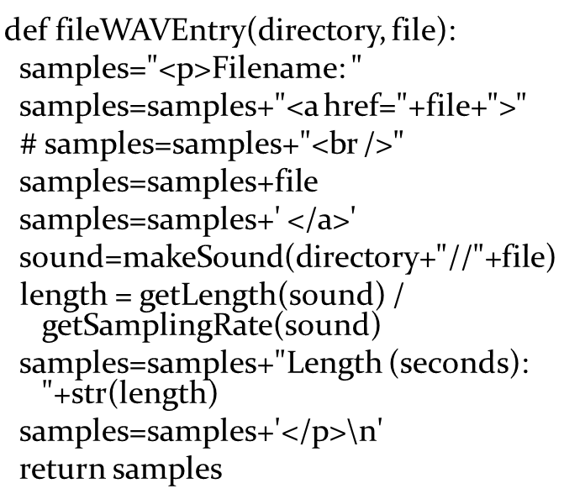
W A V and J P E G File Entry Functions

Slide 31
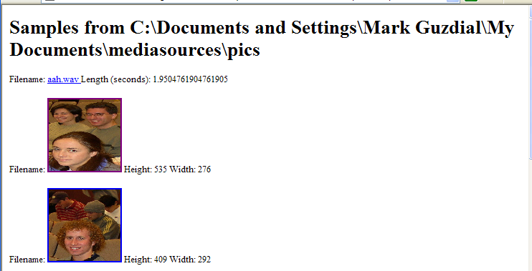
Running the New Program

Slide 32
Not Really Modular
In a modular program (a program that has “good modularity”) each function does one and only one task well.
Look at all the duplicated code in the two file entry functions.
Could we pull that out into yet another function?

Slide 33
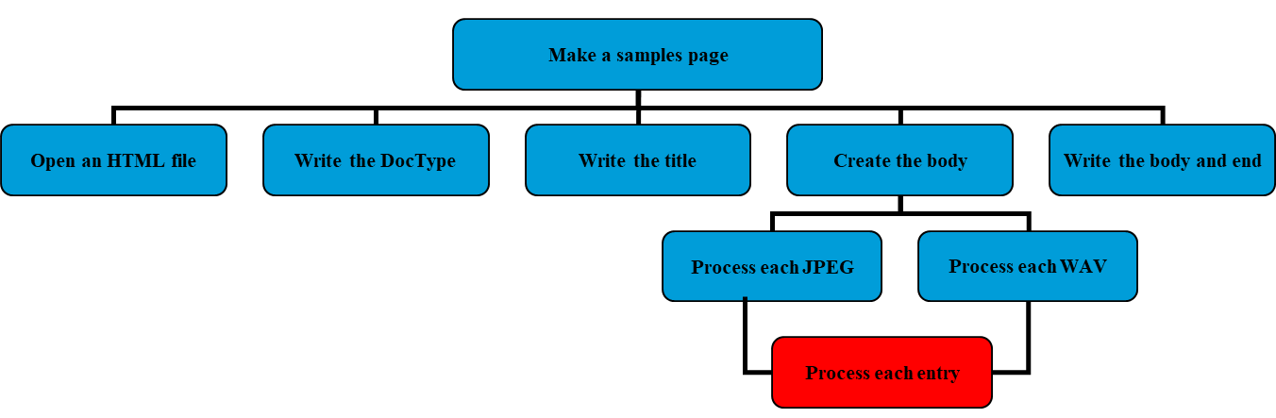
Creating a Sub-Sub-Function

Slide 34
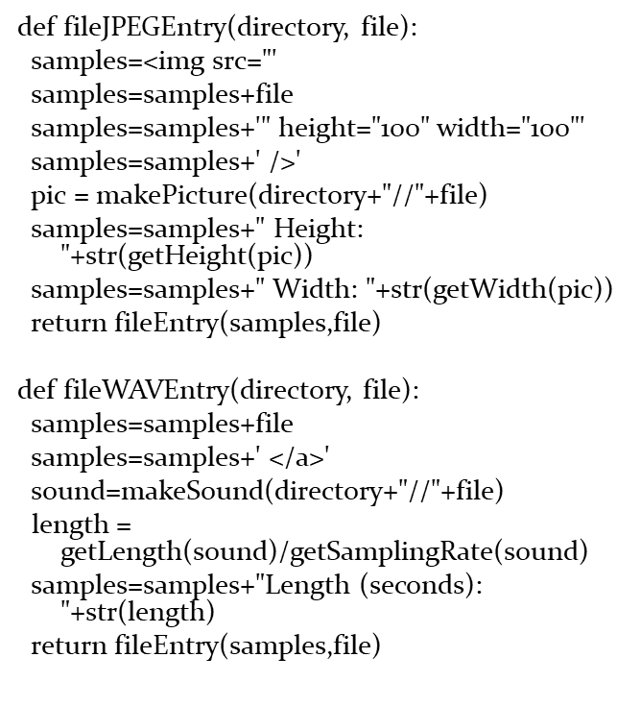
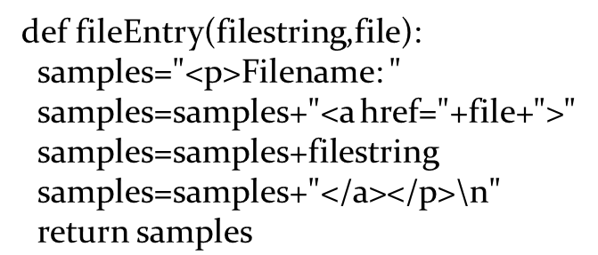
Pulling out the Sub-Sub-Function
fileEntry builds the
tag, using an anchor (filestring) and a filename (file).

Slide 35
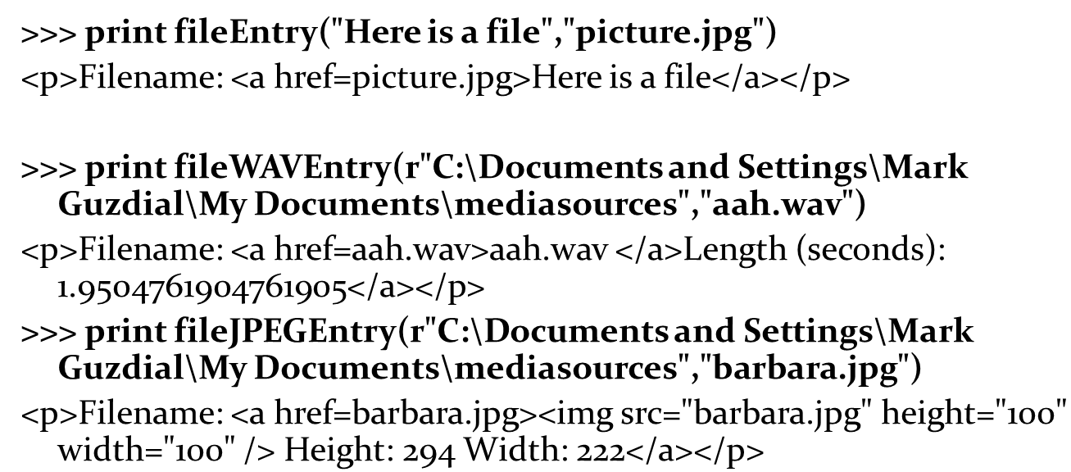
Can Test Functions Separately (1 of 2)

Slide 36
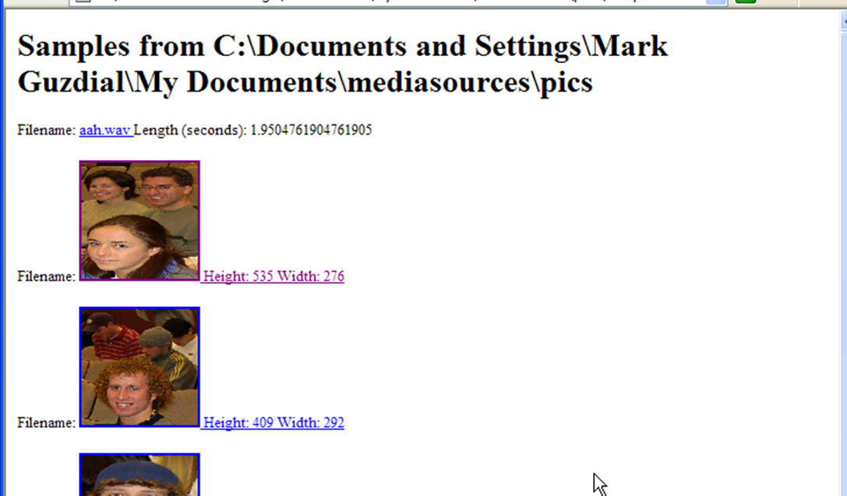
Can Test Functions Separately (2 of 2)
makeSamplePage(r"C:\Documents and Settings\Mark Guzdial\My Documents\mediasources\pics")

Slide 37
Reusability: The Reason Why Professionals Value Modularity
When a function does one and only one thing, it can easily be reused in new situations.
Consider how we reused the sunset function and the swap background functions in the movie code.
Think about what would have happened if those functions also showed every picture.
They literally couldn’t be used to do the movies, because you’d get 100 windows popping up.
Professionals will create a library of their own reusable functions that they’ll use in their work.
That’s why we have modules and the import statement: To make that kind of library easier to use.

Slide 38
Summary: Why We Use Functions
Hides details so that you can ignore them.
Makes it clear where you should make changes.
If you need to change the title, it’s probably in the title() function.
Makes testing easier.
Helps you in writing new programs because you can reuse trusted, useful functions.

Slide 39
Want to Write Fewer Lines of Code?
You can write fewer lines of code and get the same programs written, if you’re willing to trust your functions.
When you really understand functions, you can do all kinds of amazing things in very few lines of code.
Use functions that apply functions to data.
Use recursion: Have functions that call themselves.

Slide 40
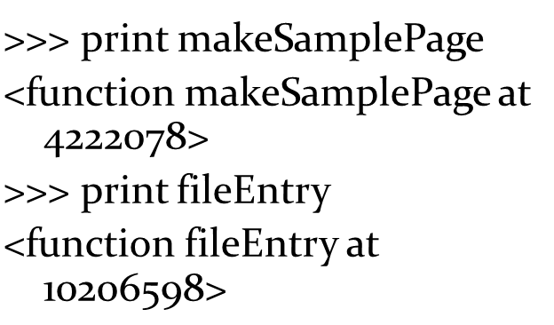
Functions are Just Values Associated with Names
We call a function by stating its name followed by inputs in parentheses.
Without parentheses, the name of the function still has a value.
It’s the function!
Functions are also data.
They can be used as input to other functions!

Slide 41
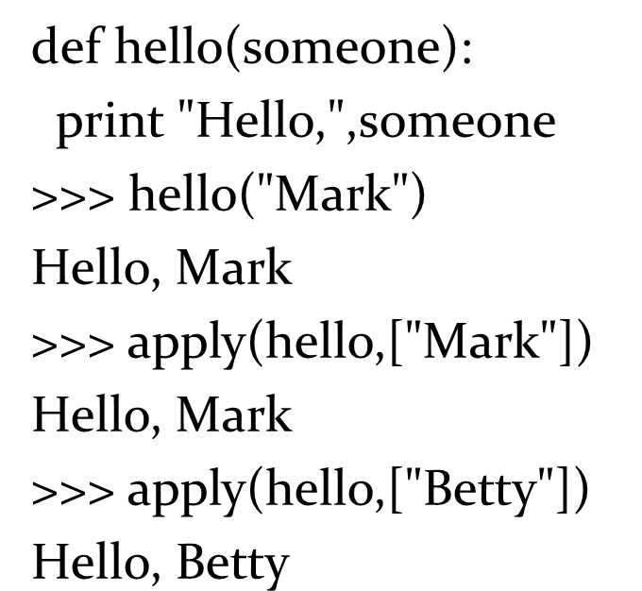
Introducing Apply
Apply takes a function as input and the inputs to that function in a sequence.
Apply literally applies the function to the input.

Slide 42
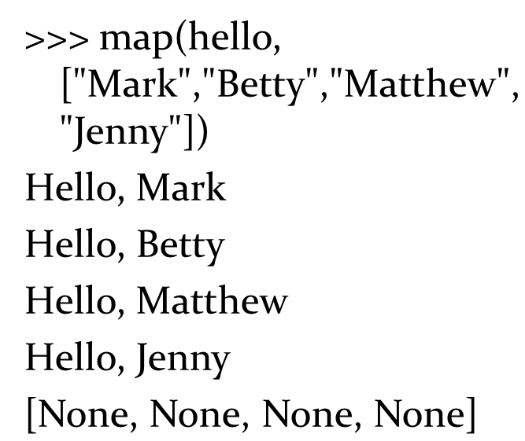
More Useful: Map
Map is a function that takes as input a function and a sequence.
But it applies the function to each input in the sequence, and returns whatever the function returns for each.

Slide 43
Filter: Returns Those for Whom the Function is True
Filter also takes a function and a sequence as input.
It applies the function to each element of the sequence.
If the return value of the function is true (1), then filter returns that element.
If the return value of the function is false (0), then filter skips that element.

Slide 44
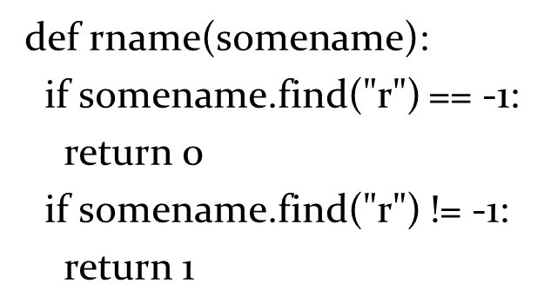
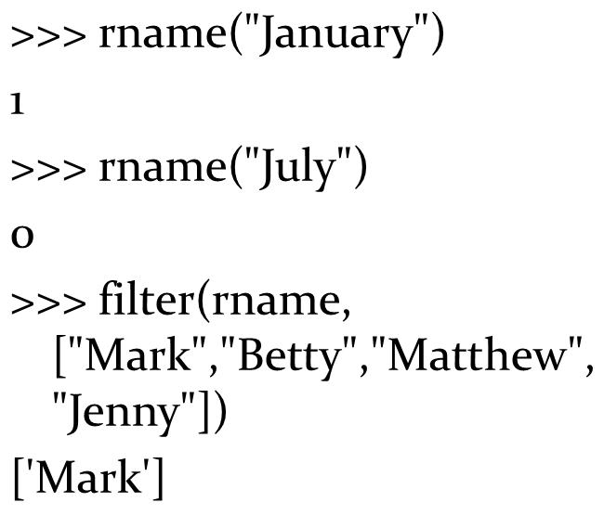
Filter Example

Slide 45
We Can Make rname Shorter Using a Logical Operator
An expression like somename.find(“r”)
actually
does evaluate to 0 (false) or 1 (true).
There are operations we can perform on logical values.
Just like + is an operation on numbers and strings.
One of these is not
It creates the opposite of whatever the input value is, true or false.

Slide 46
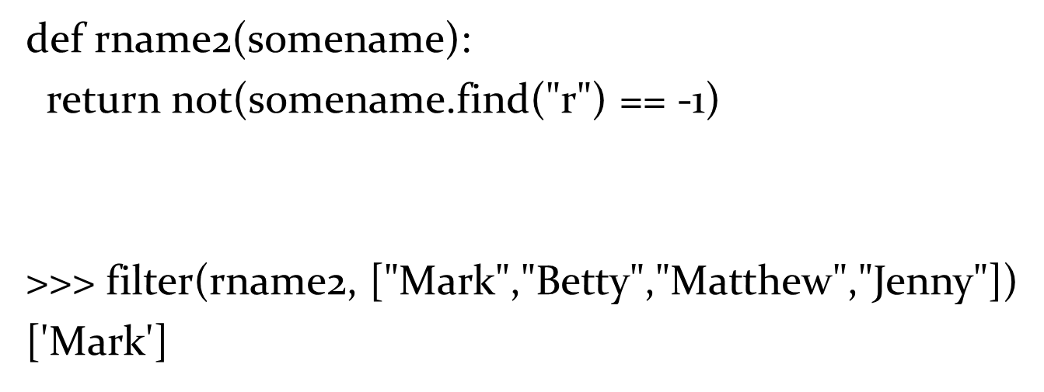
Making Rname Shorter

Slide 47
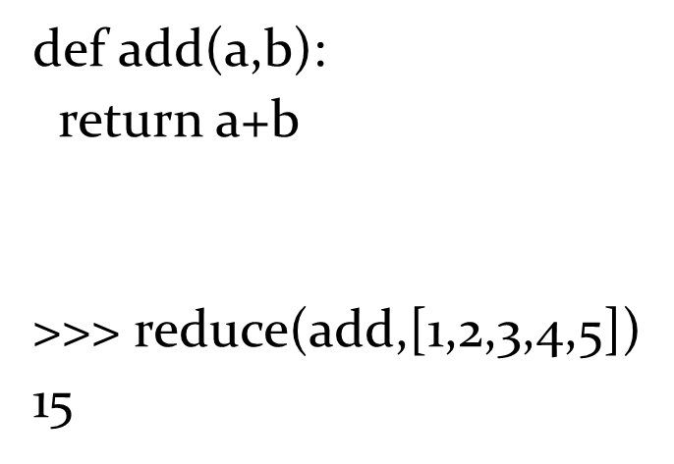
Reduce: Combine the Results
Reduce takes a function and a sequence, like the others.
But reduce combines the results.
In this example, we total all the numbers by adding 1+2, then (1+2) + 3, then (1+2+3)+4, then (1+2+3+4)+5

Slide 48
Do We Really Need to Define Add?
Turns out that we don’t even have to give a function a name to be able to use it.
A name-less function is called a lambda
It’s an old name, that actually dates back to one of the very oldest programming languages, Lisp.
Wherever you’d use a function name, you can just stick in a lambda
Lambda takes the input variables, colon, and the body of the function (usually just a single line, or else you’d want to name the function.)

Slide 49
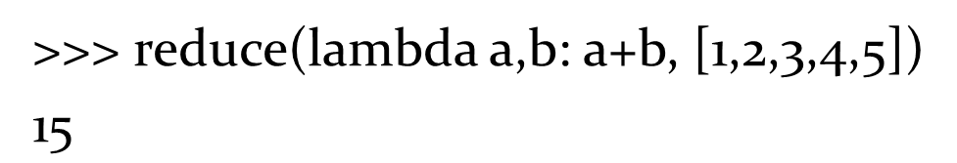
Using Lambda
This does the exact same thing.

Slide 50
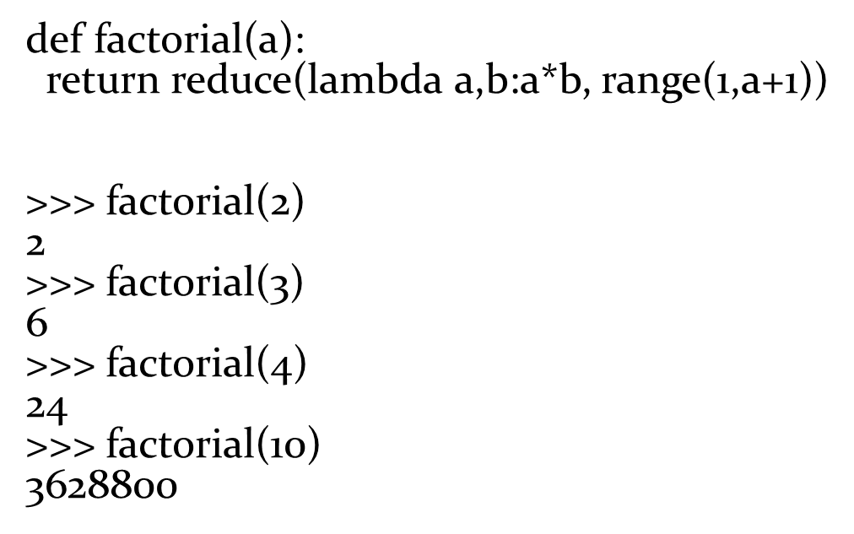
Defining Factorial with Reduce and Lambda
Remember factorial from math class:
Factorial of n is

Slide 51
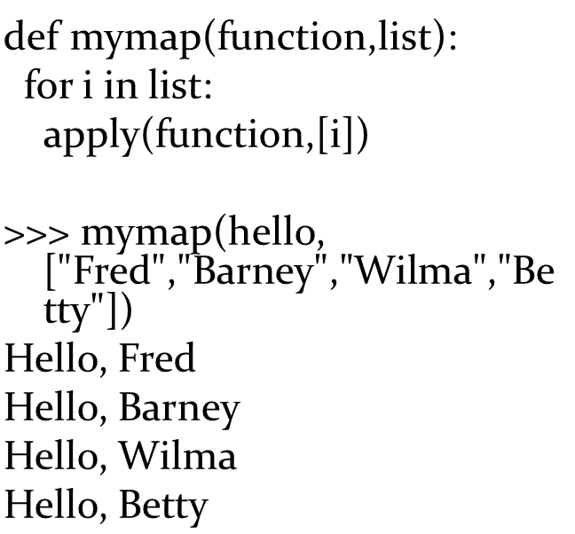
Why’d We Learn About Apply?
Map and filter (as we’ll soon see) can really be used to implement real programs.
Why apply?
Because that’s how map and filter are implemented!
Given apply, you can roll your own.

Slide 52
Interesting…but Useful? Yes!
These are really interesting ideas:
Functions are data that can be used as inputs.
We can create functions that manipulate functions.
Meta-functions?
This is functional programming
The style (paradigm) we’ve been doing so-far is called procedural.
We define processes: Procedures.

Slide 53
Functional Programming
Functional programming is about using layers of functions and functions that apply functions to solve problems.
It’s a powerful form of programming, allowing you to do a lot in very few lines of code.
Functional programming is particularly useful in artificial intelligence (A I) research and in building prototypes of systems.
These are both places where the problems are hard and ill-defined, so you want to get as far as possible with as few lines as possible.
Functional programming is also used in large server farms (like Google’s), using MapReduce or Hadoop.

Slide 54
Challenge
Look up MapReduce and Hadoop on-line. What are they?

Slide 55
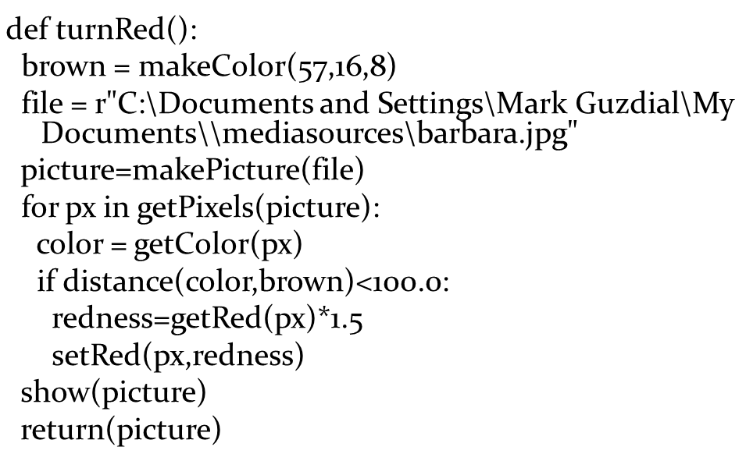
Making Turnred Functional

Slide 56
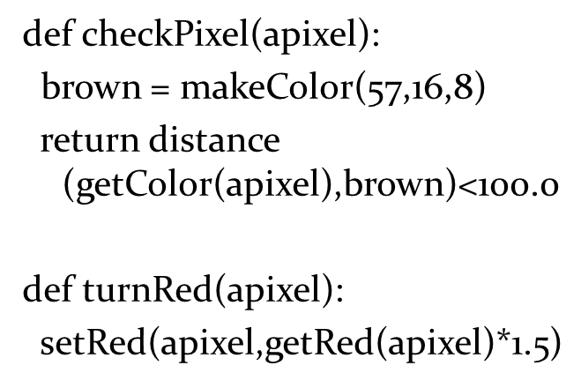
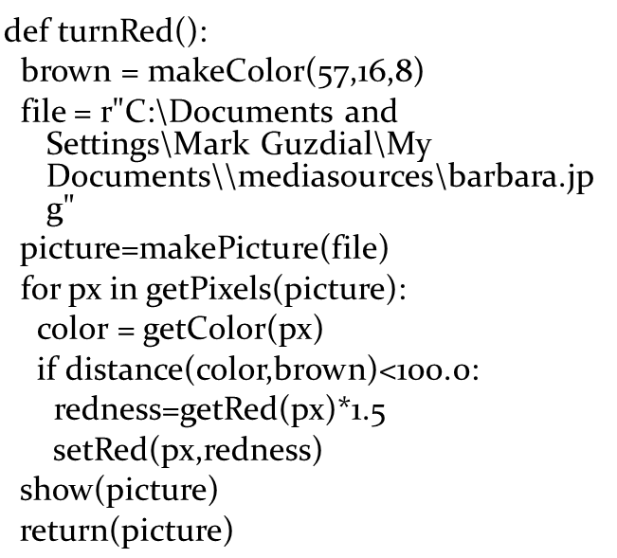
Let’s Make It a Functional Program
For comparison:

Slide 57

It’s Now Just a One Line Program
What we want to do is filter out pixels that match checkPixel,
then map the function turnRed to that result.

Slide 58
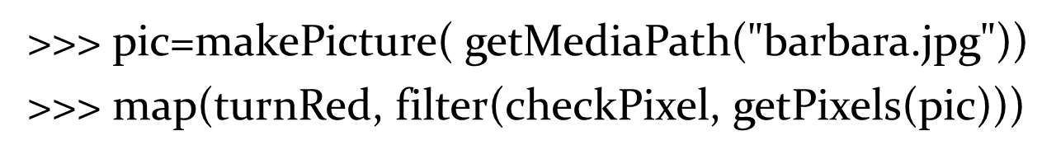
Really Using the One-Liner

Slide 59
Challenge: One Line
Rewrite this function with just lambda’s! Then it really is just a single line of code!

Slide 60
A New Way of Thinking
In functional programming, you don’t write functions with big loops that process all the data.
Instead, you write small functions that process one piece of the data.
Then you apply the small function to all the data, using things like map and filter.
You end up writing fewer lines of code for solving problems.

Slide 61
Programming Without State
Algebraic functions don’t change their inputs
Sin(4) doesn’t redefine “4”
The fact that increaseRed(p i c) changes p i c makes it non-algebraic.
We can redefine functions so that they don’t change the inputs.

Slide 62
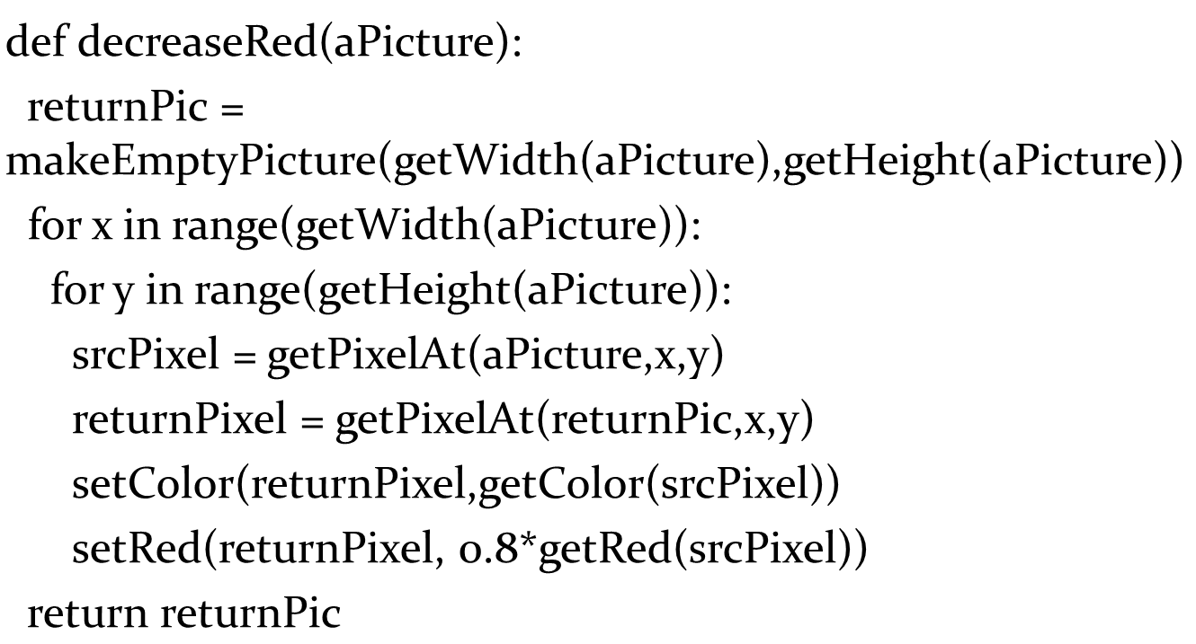
Decreasered Without Changing Input

Slide 63
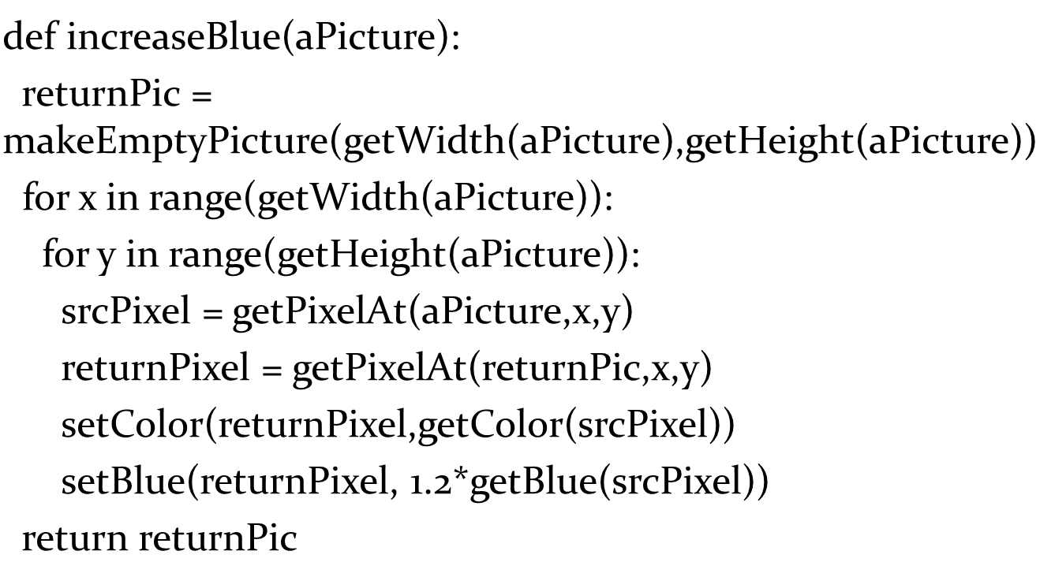
Increaseblue Without Changing Input

Slide 64
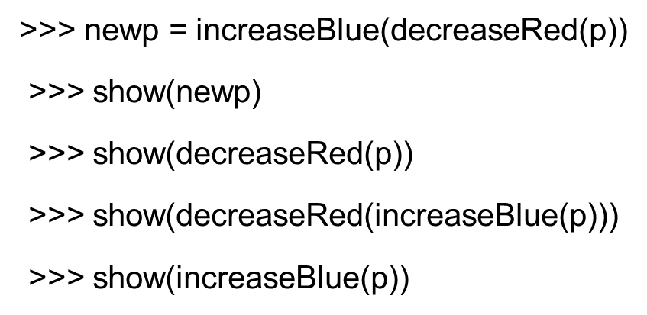
Now, We Can Nest Like Algebra

Slide 65
A Very Powerful Idea: Recursion
Recursion is writing functions that call themselves.
When you write a recursive function, you write (at least) two pieces:
What to do if the input is the smallest possible datum,
What to do if the input is larger so that you:
(a) process one piece of the data
(b) call the function to deal with the rest.

Slide 66
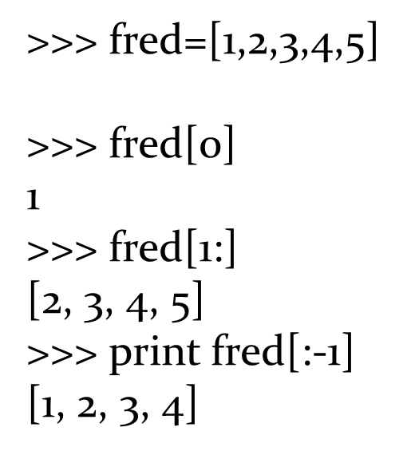
First, a Reminder of Lists
In functional programming languages, there are usually functions called head and rest for these two operations.
They’re very common in recursion.

Slide 67


A Recursive Decreasered
If the list (of pixels) is empty, don’t do anything
Just return
Otherwise,
Decrease the red in the first pixel.
Call decreaseRed on the rest of the pixels.
Call it like:
This actually won’t work for reasonable-sized pictures—takes up too much memory in Java.

Slide 68
Recursion Can be Hard to Get Your Head Around
It really relies on you trusting your functions.
They’ll do what you tell them to do.
So if a function decreases red on a list of pixels, just let it do that!
Let’s try some different ways to think about recursion.
But first, let’s take a smaller problem.

Slide 69

DownUp
Let’s define a function called downUp

Slide 70
3 Ways to Understand Recursion
Procedural abstraction
Trace it out (use a small problem like downUp to do this)
Little people method

Slide 71
1. Procedural Abstraction
Break the problem down into the smallest pieces that you can write down easily as a function.
Re-use as much as possible.

Slide 72


Downup for One Character Words
Obviously, this works:

Slide 73

Downup for 2 Character Words
We’ll reuse downUp1 since we have it already.

Slide 74

downup3 for 3 Character Words
Are we seeing a pattern yet?

Slide 75

Let’s Try Our Pattern

Slide 76

It Starts Right!

Slide 77

How Do We Stop?
If we have only one character in the word, print it and STOP!

Slide 78

That Works

Slide 79

2. Let’s Trace What Happens
The len(word) is not 1, so we print the word
Hello
Now we call downUp(“ello”)
Still not one character, so print it
ello
Now we call downUp(“llo”)
Still not one character, so print it
llo

Slide 80
Still Tracing
downUp(“lo”)
Still not one character, so print it
lo
Now call downUp(“o”)
THAT’S ONE CHARACTER! PRINT IT AND RETURN!
o

Slide 81
On the Way Back out
downUp(“lo”) now continues from its call to downUp(“o”), so it prints again and ends.
lo
downUp(“llo”) now continues (back from downUp(“lo”))
It prints and ends.
llo
downUp(“ello”) now continues.
It prints and ends.
ello
Finally, the last line of the original downUp(“Hello”) can run.
Hello

Slide 82
3. Little Elves
Some of the concepts that are hard to understand:
A function can be running multiple times and places in memory, with different input.
When one of these functions end, the rest still keep running.
A great way of understanding this is to use the metaphor of a function call (a function invocation) as an elf.
(We can use students in the class as elves.)

Slide 83
E l f Instructions:
Accept a word as input.
If your word has only one character in it, write it on the screen and you’re done! Stop and sit down.
Write your word down on the “screen”
Hire another elf to do these same instructions and give the new elf your word minus the first character.
Wait until the elf you hired is done.
Write your word down on the “screen” again.
You’re done!
Notes:
Let's really do this! Print out the instructions or leave them on the screen. Use 3x5 cards to represent the input. Let the “screen” be another computer or the whiteboard. “Hire” someone from the audience. Sit down when done.

Slide 84

Exercise!
Try writing upDown

Slide 85

Recursive Directory Traversals
On your disk, there are folders inside of folders.
The folder is made up of folders (and files).
How do we process all files in a folder, including all the subfolders?
Use recursion!

Slide 86

Listing All Files, Recursively
If the file is a directory, list it just like this directory (recursive call).
If it is not (else), just print the filename

Slide 87

Testing the Function

Slide 88

Recursing, Differently
This has trouble, in part, because all the list of pixels is being passed in each call.

Slide 89

Store the List in a “Global”
aPicturePixels, created outside of any function is “global” – accessible from any function in the file.
Now, only the index number is passed along.

Slide 90
Why Use Functional Programming and Recursion?
Can do a lot in very few lines.
Very useful techniques for dealing with hard problems.
ANY kind of loop (FOR, WHILE, and many others) can be implemented with recursion.
It’s the most flexible and powerful form of looping.

Slide 91

Copyright

